Slide 1
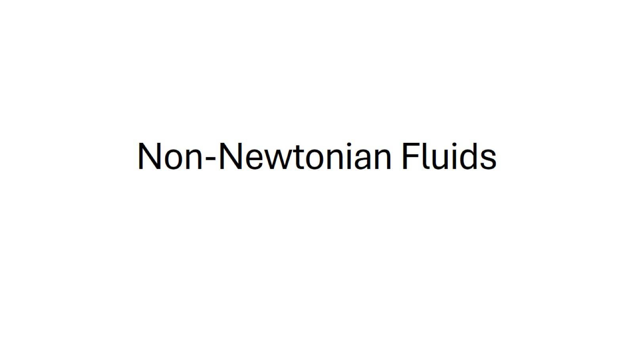
Non-Newtonian Fluids

Slide 2
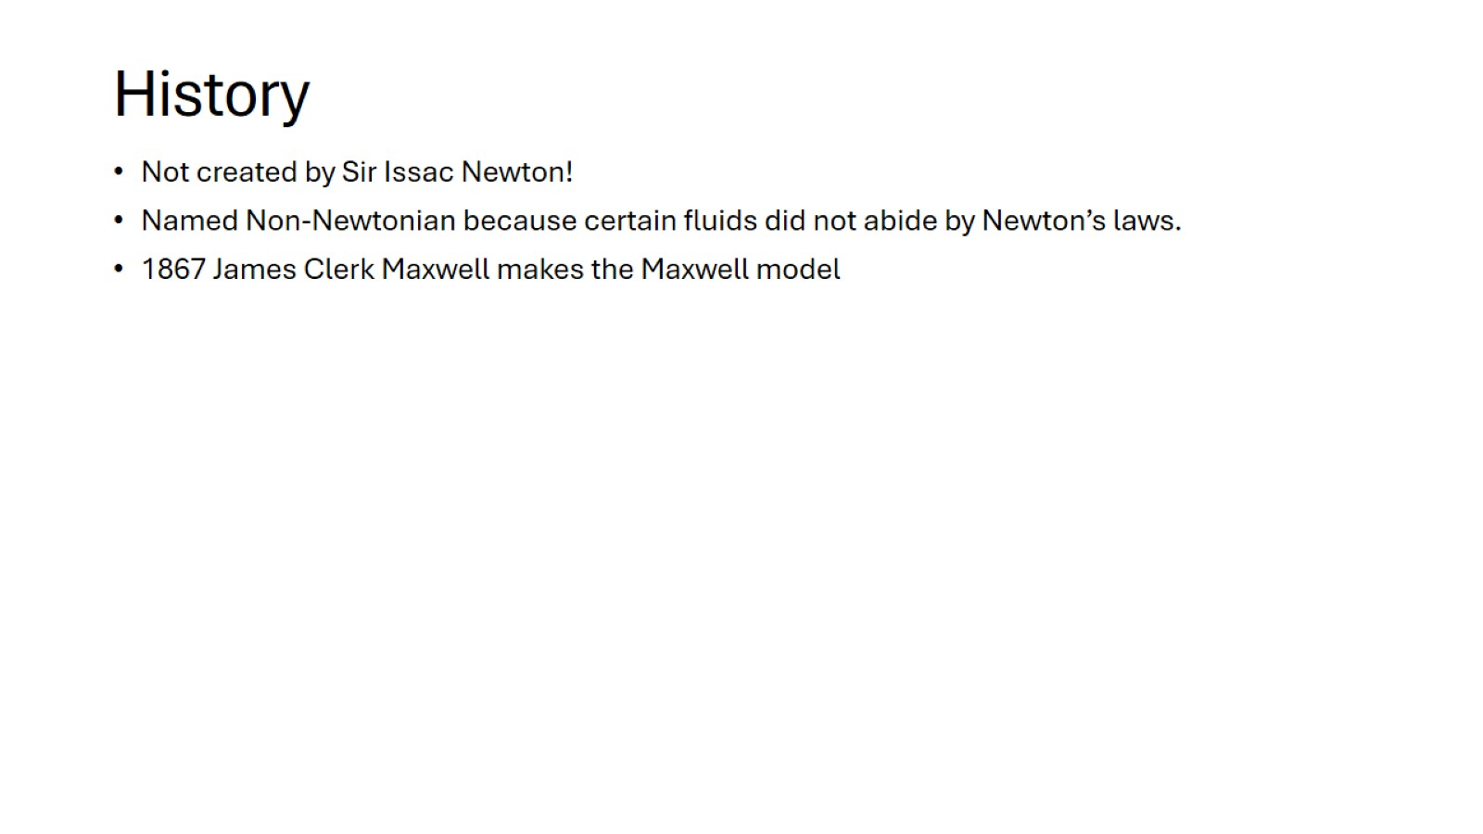
History

Slide 3
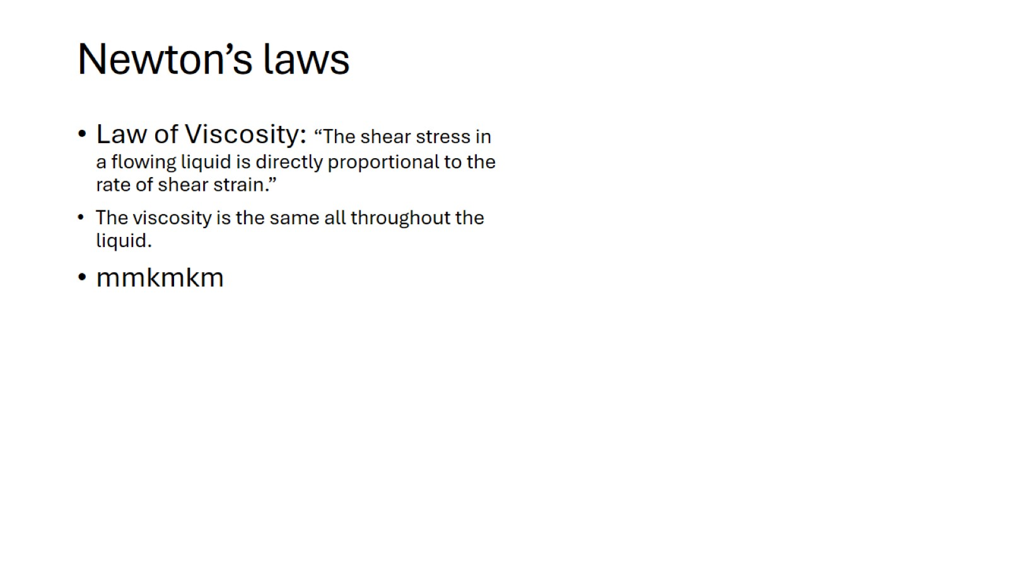
Newton’s laws

Slide 5
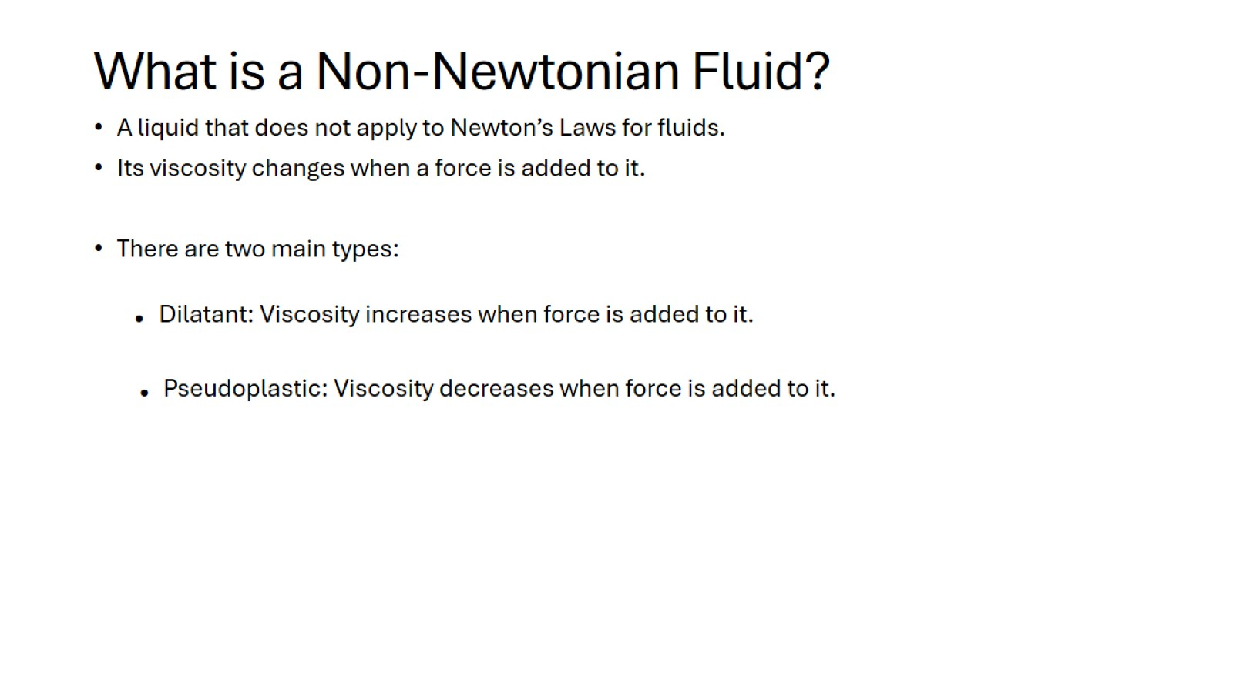
What is a Non-Newtonian Fluid?

Slide 6
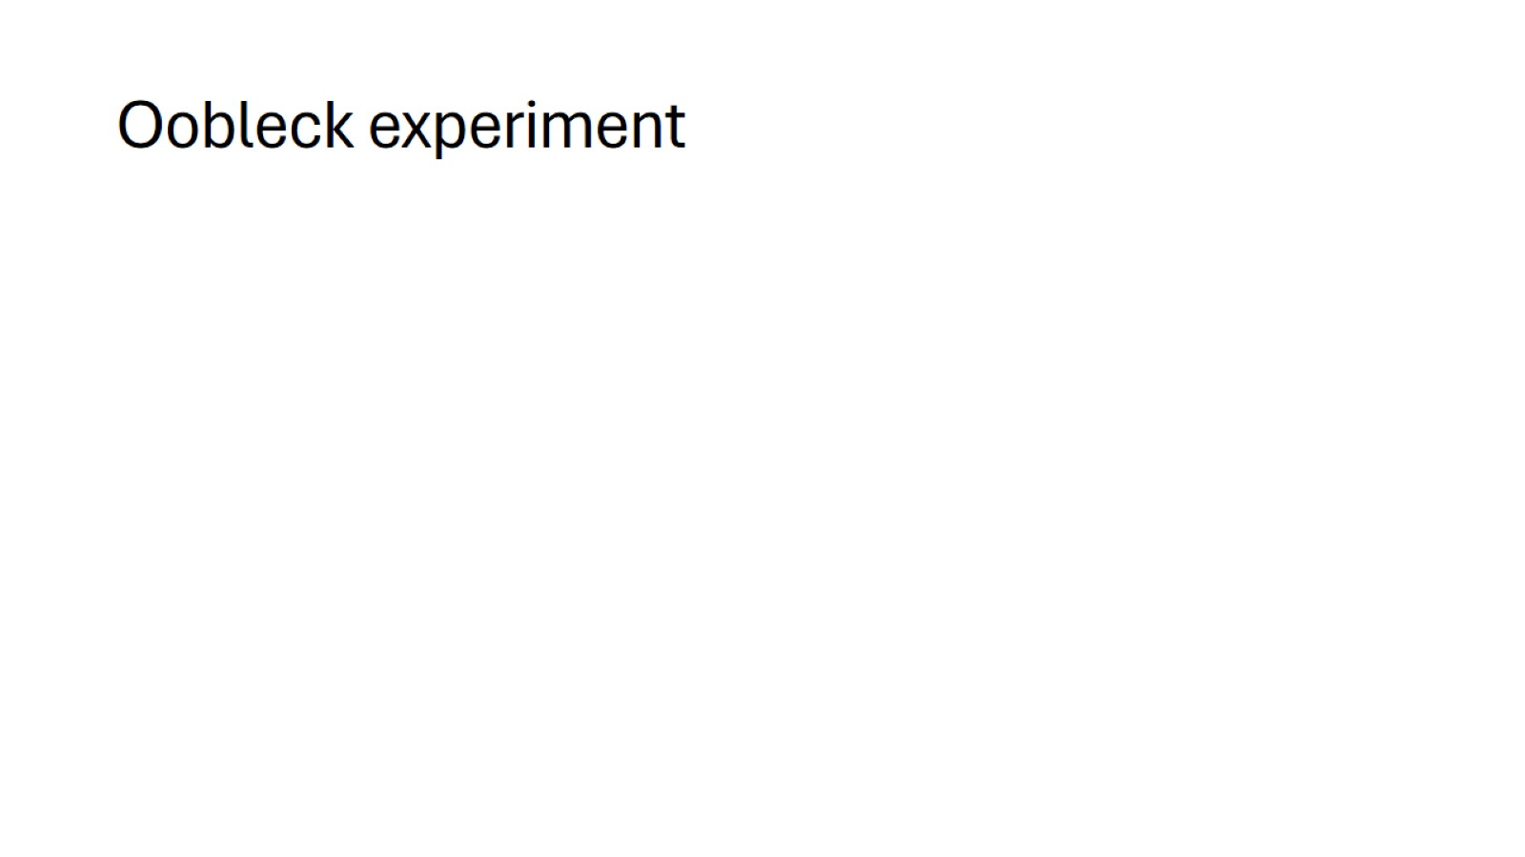
Oobleck experiment

